Slide 1
Persistence: I/O devices
Questions answered in this lecture:
How does the OS interact with I/O devices (check status, send data+control)?
What is a device driver?
What are the components of a hard disk drive?
How can you calculate sequential and random throughput of a disk?
What algorithms are used to schedule I/O requests?

Slide 2
I/O Devices

Slide 3
Motivation
What good is a computer without any I/O devices?
keyboard, display, disks
We want:
H/W that will let us plug in different devices
OS that can interact with different combinations

Slide 4
Hardware support for I/O
CPU
RAM
Memory Bus
General I/O Bus
(e.g., PCI)
Graphics
Peripheral I/O Bus
(e.g., SCSI, SATA, USB)
Why use hierarchical buses?

Slide 5
Hardware support for I/O
CPU
RAM
Memory Bus
12.8GB/s
General I/O Bus
(e.g., PCI)
Graphics
PCI: 533MB/s
PCIe:250MB/s~
7.88GB/s
Peripheral I/O Bus
(e.g., SCSI, SATA, USB)
320MB/s
150MB/s~
1.97GB/s
1.5MB/s~
1.21GB/s
Why use hierarchical buses?

Slide 6
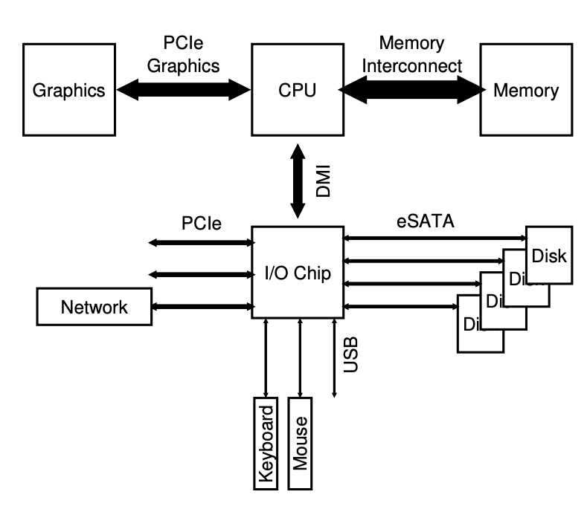
Hardware support for I/O
北桥芯片
Direct Media Interface
南桥芯片
Intel Z270 chipset
Why use hierarchical buses?

Slide 7
Hardware support for I/O
 | DDR | DDR2 | DDR3 | DDR4 | DDR5
Trans Rate (GB/s) | 2.1 - 3.2 | 4.2 - 6.4 | 8.5 - 14.9 | 17 - 25.6 | 38.4 - 51.2
single-lane (x1):
250MB/s(v1)～15.13GB/s(v7)
2GT/s～16GT/s
300MB/s～600MB/s
NVMe
500MB/s(USB 3.0)～1.21GB/s(3.1)
Others:
CXL(Compute Express Link)(×1): 3.9GB/s~7.56GB/s
RDMA: 40GB/s
https://en.wikipedia.org/wiki/Direct_Media_Interface
https://en.wikipedia.org/wiki/PCI_Express
https://en.wikipedia.org/wiki/Compute_Express_Link
Notes:
GT/s（Giga-transfers per second）：这是一个单位，用于表示每秒传输的数据传输次数。它通常用于描述总线、信号传输或通信速度。1 GT/s等于每秒进行十亿次数据传输。这是一个纯粹的计数单位，不涉及传输的数据量大小。
GB/s用于描述传输速度，表示每秒传输的数据量大小，通常以字节为单位。
通常，GT/s和GB/s之间的关系取决于传输的数据位宽度。如果你知道每次传输的位数和每秒的传输次数，你可以将其转化为GB/s，以便更容易理解数据传输速度的实际数据量。

Slide 8
Why hierarchical buses?
Physics and cost
Faster bus
The faster a bus is, the shorter it must be
no room to plug more devices
costly
Slower bus
no demand for higher speed
more devices
Notes:
Why: physics and cost
信号传输延迟
信号衰减
成本和复杂性
电磁干扰和串扰

Slide 9
Canonical Device
OS reads/writes to these
Device Registers:
Status
COMMAND
DATA

Slide 10
Canonical Device
OS reads/writes to these
Device Registers:
Status
COMMAND
DATA
Hidden Internals:
???

Slide 11
Canonical Device
OS reads/writes to these
Device Registers:
Status
COMMAND
DATA
Microcontroller (CPU+RAM)
Extra RAM
Other special-purpose chips
Hidden Internals:

Slide 12
Example Write Protocol
Status
COMMAND
DATA
Microcontroller (CPU+RAM)
Extra RAM
Other special-purpose chips
while (STATUS == BUSY)
; // spin
Write data to DATA register
Write command to COMMAND register
while (STATUS == BUSY)
; // spin
Notes:
spin=wait until device is not busy

Slide 13
CPU:
Disk:
while (STATUS == BUSY) // 1
;
Write data to DATA register // 2
Write command to COMMAND register // 3
while (STATUS == BUSY) // 4
;

Slide 14
CPU:
A
Disk:
C
while (STATUS == BUSY) // 1
;
Write data to DATA register // 2
Write command to COMMAND register // 3
while (STATUS == BUSY) // 4
;

Slide 15
A wants to do I/O
CPU:
A
Disk:
C
while (STATUS == BUSY) // 1
;
Write data to DATA register // 2
Write command to COMMAND register // 3
while (STATUS == BUSY) // 4
;

Slide 16
1
CPU:
A
Disk:
C
while (STATUS == BUSY) // 1
;
Write data to DATA register // 2
Write command to COMMAND register // 3
while (STATUS == BUSY) // 4
;

Slide 17
1
2
CPU:
A
Disk:
C
A
while (STATUS == BUSY) // 1
;
Write data to DATA register // 2
Write command to COMMAND register // 3
while (STATUS == BUSY) // 4
;

Slide 18
3
1
2
CPU:
A
Disk:
C
A
while (STATUS == BUSY) // 1
;
Write data to DATA register // 2
Write command to COMMAND register // 3
while (STATUS == BUSY) // 4
;

Slide 19
3
1
2
4
CPU:
A
Disk:
C
A
while (STATUS == BUSY) // 1
;
Write data to DATA register // 2
Write command to COMMAND register // 3
while (STATUS == BUSY) // 4
;

Slide 20
3
1
2
4
CPU:
A
Disk:
C
A
while (STATUS == BUSY) // 1
;
Write data to DATA register // 2
Write command to COMMAND register // 3
while (STATUS == BUSY) // 4
;

Slide 21
3
1
2
4
CPU:
A
B
Disk:
C
A
while (STATUS == BUSY) // 1
;
Write data to DATA register // 2
Write command to COMMAND register // 3
while (STATUS == BUSY) // 4
;

Slide 22
Protocol Variants
Status
COMMAND
DATA
Microcontroller (CPU+RAM)
Extra RAM
Other special-purpose chips
Status checks: polling vs. interrupts
Data: PIO vs. DMA
Control: special instructions vs. memory-mapped I/O
Lowering CPU Overhead With Interrupts

Slide 23
3
1
2
4
CPU:
A
B
Disk:
C
A
while (STATUS == BUSY) // 1
; // spin/polling
Write data to DATA register // 2
Write command to COMMAND register // 3
while (STATUS == BUSY) // 4
; // spin/polling
how to avoid spinning?
interrupts!

Slide 24
how to avoid spinning?
interrupts!
3
1
2
4
CPU:
A
B
Disk:
C
A
while (STATUS == BUSY) // 1
sleep & wait for interrupt;
Write data to DATA register // 2
Write command to COMMAND register // 3
while (STATUS == BUSY) // 4
sleep & wait for interrupt;

Slide 25
A CPU-Disk pipieline that enables computation and I/O overlapping
3,4
1
2
CPU:
A
B
A
B
A
B
Disk:
C
A
while (STATUS == BUSY) // 1
sleep & wait for interrupt;
Write data to DATA register // 2
Write command to COMMAND register // 3
while (STATUS == BUSY) // 4
sleep & wait for interrupt;

Slide 26
Interrupts vs. Polling
Are interrupts ever worse than polling?
The overhead of task switching is expensive
Fast device: Better to spin than take interrupt overhead
Device time unknown? Hybrid approach (spin then use interrupts)
Flood of interrupts arrive
Can lead to livelock (always handling interrupts)
Better to ignore interrupts while make some progress handling them
Other improvement
Interrupt coalescing (batch together several interrupts)

Slide 27
Protocol Variants
Status
COMMAND
DATA
Microcontroller (CPU+RAM)
Extra RAM
Other special-purpose chips
Status checks: polling vs. interrupts
Data: PIO vs. DMA
Control: special instructions vs. memory-mapped I/O
Lowering CPU Overhead With Interrupts
More Efficient Data Movement With DMA

Slide 28
Programmed I/O (PIO)
3,4
1
2
CPU:
A
B
A
B
A
B
Disk:
C
A
while (STATUS == BUSY) // 1
sleep & wait for interrupt;
Write data to DATA register // 2
Write command to COMMAND register // 3
while (STATUS == BUSY) // 4
sleep & wait for interrupt;
What else can we optimize?
Data Movement!

Slide 29
Programmed I/O vs. Direct Memory Access
PIO (Programmed I/O):
CPU directly tells device what the data is
DMA (Direct Memory Access):
CPU leaves data in memory
Device reads data directly from memory

Slide 30
3,4
1
2
CPU:
A
B
A
B
A
B
Disk:
C
A
while (STATUS == BUSY) // 1
sleep & wait for interrupt;
Write data to DATA register // 2
Write command to COMMAND register // 3
while (STATUS == BUSY) // 4
sleep & wait for interrupt;

Slide 31
3,4
1
2
CPU:
A
B
A
B
A
B
Disk:
C
A
while (STATUS == BUSY) // 1
sleep & wait for interrupt;
Write data to DATA register // 2
Write command to COMMAND register // 3
while (STATUS == BUSY) // 4
sleep & wait for interrupt;

Slide 32
1
3,4
CPU:
A
B
B
A
Disk:
C
A
while (STATUS == BUSY) // 1
sleep & wait for interrupt;
Write data to DATA register // 2
Write command to COMMAND register // 3
while (STATUS == BUSY) // 4
sleep & wait for interrupt;

Slide 33
Protocol Variants
Status
COMMAND
DATA
Microcontroller (CPU+RAM)
Extra RAM
Other special-purpose chips
Status checks: polling vs. interrupts
Data: PIO vs. DMA
Control: special instructions vs. memory-mapped I/O
Lowering CPU Overhead With Interrupts
More Efficient Data Movement With DMA
Methods Of Device Interaction(How to communicate with devices？)

Slide 34
1
3,4
CPU:
A
B
B
A
Disk:
C
A
while (STATUS == BUSY) // 1
sleep & wait for interrupt;
Write data to DATA register // 2
Write command to COMMAND register // 3
while (STATUS == BUSY) // 4
sleep & wait for interrupt;
how does OS read and write registers?

Slide 35
Special Instructions vs. Mem-Mapped I/O
Special instructions
each device has a port
in/out instructions (x86) communicate with device
Memory-Mapped I/O
H/W maps registers into address space
loads/stores sent to device
Doesn’t matter much (both are used)

Slide 36
Protocol Variants
Status
COMMAND
DATA
Microcontroller (CPU+RAM)
Extra RAM
Other special-purpose chips
Status checks: polling vs. interrupts
Data: PIO vs. DMA
Control: special instructions vs. memory-mapped I/O
Lowering CPU Overhead With Interrupts
More Efficient Data Movement With DMA
Methods Of Device Interaction

Slide 37
Variety is a Challenge
Problem:
many, many devices
each has its own protocol
How can we avoid writing a slightly different OS for each H/W combination? (How to build a device-neutral OS?)
Abstract a device with a driver
Write device driver for each device
Drivers are 70% of Linux source code

Slide 38
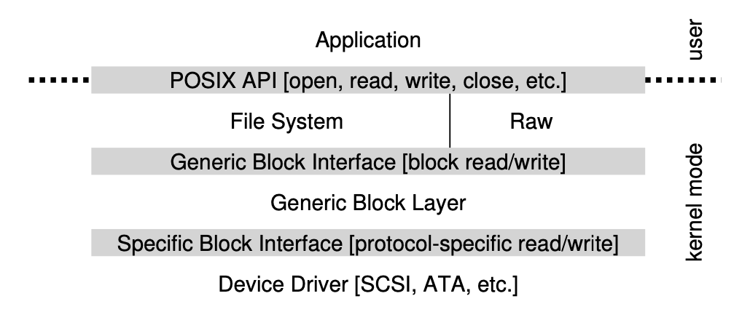
File System Stack
Notes:
The diagram also shows a raw interface to devices, which enables spe- cial applications (such as a file-system checker, described later [AD14], or a disk defragmentation tool) to directly read and write blocks without using the file abstraction. Most systems provide this type of interface to support these low-level storage management applications.

Slide 39
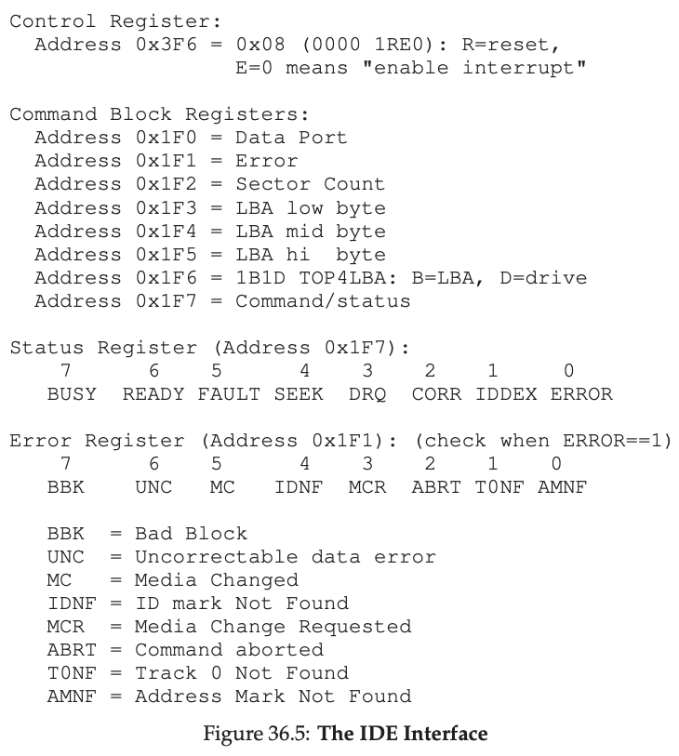
A Simple Device Driver

Slide 40
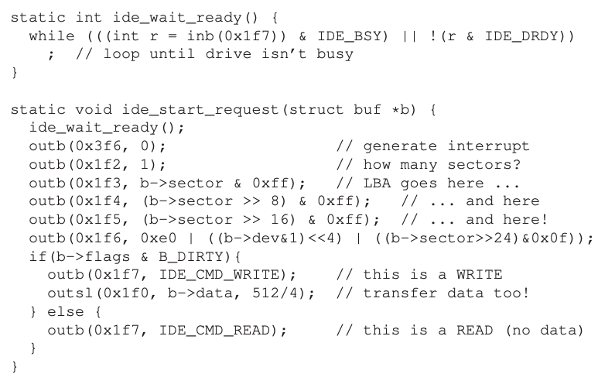
A Simple Device Driver
Spin for ready
enable
LBA = logical block address -> sector

Slide 41
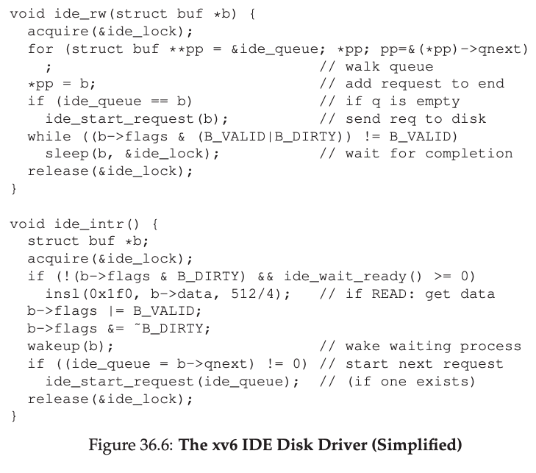
A Simple Device Driver
Read or write
Interrupt procedure

Slide 42
Hard Disk Drives

Slide 43
Basic Interface
Disk has a sector-addressable address space
Appears as an array of sectors
Sectors are typically 512 bytes or 4096 bytes.
Main operations: reads + writes to sectors
Mechanical (slow) nature makes management “interesting”

Slide 44
Disk Internals
Platter

Slide 45
Platter is covered with a magnetic film.

Slide 46
Spindle

Slide 47
Surface
Surface

Slide 48
Many platters may be bound to the spindle.

Slide 49
Each surface is divided into rings called tracks.
A stack of tracks (across platters) is called a cylinder.

Slide 50
23
16
15
8
22
14
7
0
9
17
6
1
13
5
2
10
4
3
21
18
12
11
20
19
The tracks are divided into numbered sectors.

Slide 51
23
16
15
8
22
14
7
0
9
17
6
1
Head
5
2
13
4
3
10
21
18
Arm
12
11
20
19
Heads on a moving arm can read from each surface.

Slide 52
spin
23
16
15
8
22
14
7
0
9
17
6
1
13
5
2
10
4
3
21
18
12
11
20
19
Spindle/platters rapidly spin.

Slide 53
Disk Terminology
spindle
read/write head
platter
surface
sector
track
cylinder

Slide 54
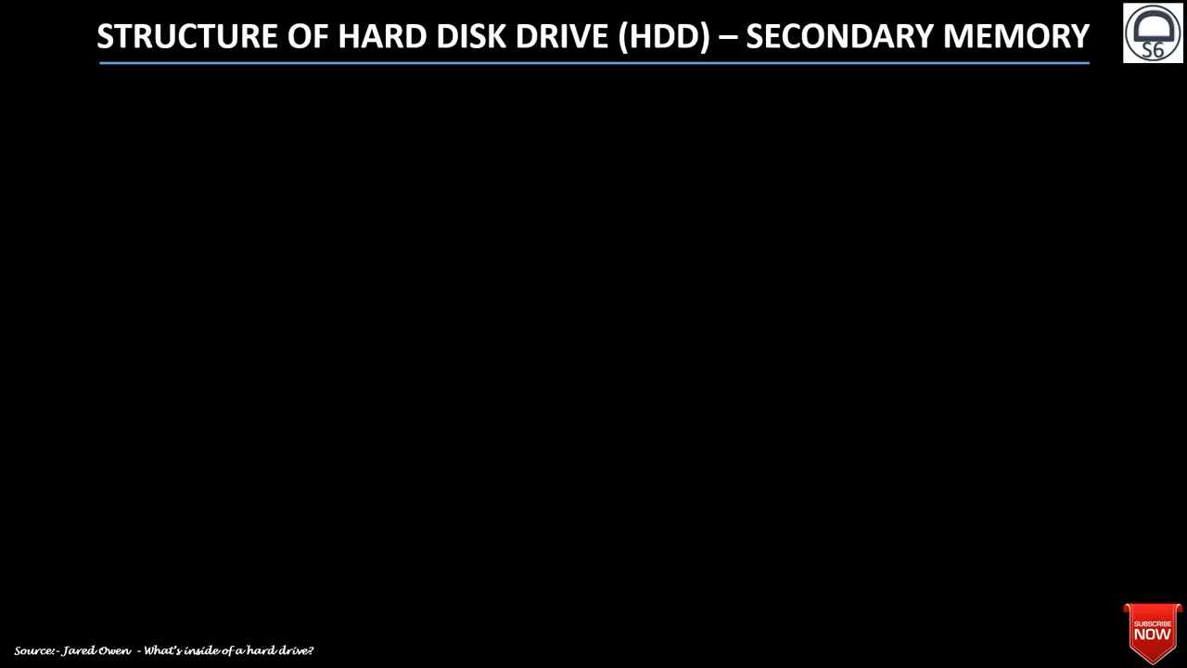
Hard Drive Demo
https://www.youtube.com/watch?v=oEORcCQ62nQ&list=PLzx7vH9ElxlxovmLf-ev2NQ1pbeKq_Zrl&index=27

Slide 55
Let’s Read 12!
23
16
15
8
22
14
7
0
9
17
6
1
13
5
2
10
4
3
21
18
12
11
20
19

Slide 56
Positioning
Drive servo system keeps head on track
How does the disk head know where it is?
Platters not perfectly aligned, tracks not perfectly concentric (runout) -- difficult to stay on track
More difficult as density of disk increase
More bits per inch (BPI), more tracks per inch (TPI)
Use servo burst:
Record placement information every few (3-5) sectors
When head cross servo burst, figure out location and adjust as needed

Slide 57
Let’s Read 12!
23
16
15
8
22
14
7
0
9
17
6
1
13
5
2
10
4
3
21
18
12
11
20
19

Slide 58
Seek to right track.
23
16
15
8
22
14
7
0
9
17
6
1
13
5
2
10
4
3
21
18
12
11
20
19

Slide 59
Seek to right track.
23
16
15
8
22
14
7
0
9
17
6
1
13
5
2
10
4
3
21
18
12
11
20
19

Slide 60
Seek to right track.
23
16
15
8
22
14
7
0
9
17
6
1
13
5
2
10
4
3
21
18
12
11
20
19

Slide 61
Wait for rotation.
23
16
15
8
22
14
7
0
9
17
6
1
13
5
2
10
4
3
21
18
12
11
20
19

Slide 62
Wait for rotation.
23
16
15
8
22
14
7
0
9
17
6
1
13
5
2
10
4
3
21
18
12
11
20
19

Slide 63
Wait for rotation.
23
16
15
8
22
14
7
0
9
17
6
1
13
5
2
10
4
3
21
18
12
11
20
19

Slide 64
Wait for rotation.
23
16
15
8
22
14
7
0
9
17
6
1
13
5
2
10
4
3
21
18
12
11
20
19

Slide 65
Wait for rotation.
23
16
15
8
22
14
7
0
9
17
6
1
13
5
2
10
4
3
21
18
12
11
20
19

Slide 66
Wait for rotation.
23
16
15
8
22
14
7
0
9
17
6
1
13
5
2
10
4
3
21
18
12
11
20
19

Slide 67
Transfer data.
23
16
15
8
22
14
7
0
9
17
6
1
13
5
2
10
4
3
21
18
12
11
20
19

Slide 68
Transfer data.
23
16
15
8
22
14
7
0
9
17
6
1
13
5
2
10
4
3
21
18
12
11
20
19

Slide 69
Transfer data.
23
16
15
8
22
14
7
0
9
17
6
1
13
5
2
10
4
3
21
18
12
11
20
19

Slide 70
Yay!
23
16
15
8
22
14
7
0
9
17
6
1
13
5
2
10
4
3
21
18
12
11
20
19

Slide 71
Time to Read/write
Three components:
Time = seek + rotation + transfer time

Slide 72
Seek, Rotate, Transfer
Seek cost: Function of cylinder distance
Not purely linear cost
Seek Phases: accelerate, coast, decelerate, settle
Settling alone can take 0.5 - 2 ms
Entire seeks often takes several milliseconds
4 - 10 ms
Approximate average seek distance = 1/3 max seek distance
Notes:
Seek what?=Seek Track(寻道)
P467: Compute the “Average”Seek

Slide 73
Seek, Rotate, Transfer
Depends on rotations per minute (RPM)
7200 RPM is common, 15000 RPM is high end.
With 7200 RPM, how long to rotate around?
1 / 7200 RPM =
1 minute / 7200 rotations =
1 second / 120 rotations =
8.3 ms / rotation
Average rotation?
8.3 ms / 2 = 4.15 ms

Slide 74
Seek, Rotate, Transfer
Pretty fast — depends on RPM and sector density
100+ MB/s is typical for maximum transfer rate
How long to transfer 512-bytes?
512 bytes * (1s / 100 MB) = 5 us

Slide 75
Workload Performance
So…
seeks are slow
rotations are slow
transfers are fast
What kind of workload is fastest for disks?
Sequential: access sectors in order (transfer dominated)
Random: access sectors arbitrarily (seek+rotation dominated)

Slide 76
Disk Spec
High Perfermance
Drive Market
Capacity
Drive Market
 | Cheetah | Barracuda
Capacity | 300 GB | 1 TB
RPM | 15,000 | 7,200
Avg Seek | 4 ms | 9 ms
Max Transfer | 125 MB/s | 105 MB/s
Platters | 4 | 4
Cache | 16 MB | 32 MB
Connects via | SCSI | SATA
Sequential workload: what is throughput for each?
Cheeta: 125 MB/s.
Barracuda: 105 MB/s.

Slide 77
Disk Spec
 | Cheetah | Barracuda
Capacity | 300 GB | 1 TB
RPM | 15,000 | 7,200
Avg Seek | 4 ms | 9 ms
Max Transfer | 125 MB/s | 105 MB/s
Platters | 4 | 4
Cache | 16 MB | 32 MB
Random workload: what is throughput for each?
(what else do you need to know?)
What is size of each random read?
Assume 16-KB reads

Slide 78
 | Cheetah | Barracuda
RPM | 15,000 | 7,200
Avg Seek | 4 ms | 9 ms
Max Transfer | 125 MB/s | 105 MB/s
How long does an average random 16-KB read take w/ Cheetah?
Seek + rotation + transfer
Seek = 4 ms

Slide 79
 | Cheetah | Barracuda
RPM | 15,000 | 7,200
Avg Seek | 4 ms | 9 ms
Max Transfer | 125 MB/s | 105 MB/s
How long does an average random 16-KB read take w/ Cheetah?
Average rotation in ms?
1
1 min
60 sec
1000 ms
avg rotation =
= 2 ms
2
15000
1 min
1 sec

Slide 80
 | Cheetah | Barracuda
RPM | 15,000 | 7,200
Avg Seek | 4 ms | 9 ms
Max Transfer | 125 MB/s | 105 MB/s
How long does an average random 16-KB read take w/ Cheetah?
Transfer of 16 KB?
= 16KB / 125 MB/s = 128 us
1 sec
1,000,000 us
transfer =
16 KB
= 125 us
125 MB
1 sec

Slide 81
 | Cheetah | Barracuda
RPM | 15,000 | 7,200
Avg Seek | 4 ms | 9 ms
Max Transfer | 125 MB/s | 105 MB/s
How long does an average random 16-KB read take w/ Cheetah?
Cheetah time = 4ms + 2ms + 128us = 6.1ms
Throughput?

Slide 82
 | Cheetah | Barracuda
RPM | 15,000 | 7,200
Avg Seek | 4 ms | 9 ms
Max Transfer | 125 MB/s | 105 MB/s
How long does an average random 16-KB read take w/ Cheetah?
Cheetah time = 4ms + 2ms + 128us = 6.1ms
16 KB
1 MB
100 ms
throughput =
= 2.5 MB/s
6.1ms
1024 KB
1 sec

Slide 83
 | Cheetah | Barracuda
RPM | 15,000 | 7,200
Avg Seek | 4 ms | 9 ms
Max Transfer | 125 MB/s | 105 MB/s
How long does an average random 16-KB read take w/ Barracuda?
Time = seek + rotation + transfer
Seek = 9ms

Slide 84
 | Cheetah | Barracuda
RPM | 15,000 | 7,200
Avg Seek | 4 ms | 9 ms
Max Transfer | 125 MB/s | 105 MB/s
How long does an average random 16-KB read take w/ Barracuda?
1
1 min
60 sec
1000 ms
avg rotation =
= 4.1 ms
2
7200
1 min
1 sec

Slide 85
 | Cheetah | Barracuda
RPM | 15,000 | 7,200
Avg Seek | 4 ms | 9 ms
Max Transfer | 125 MB/s | 105 MB/s
How long does an average random 16-KB read take w/ Barracuda?
1 sec
1,000,000 us
transfer =
16 KB
= 149 us
105 MB
1 sec

Slide 86
 | Cheetah | Barracuda
RPM | 15,000 | 7,200
Avg Seek | 4 ms | 9 ms
Max Transfer | 125 MB/s | 105 MB/s
How long does an average random 16-KB read take w/ Barracuda?
Barracuda time = 9ms + 4.1ms + 149us = 13.2ms

Slide 87
 | Cheetah | Barracuda
RPM | 15,000 | 7,200
Avg Seek | 4 ms | 9 ms
Max Transfer | 125 MB/s | 105 MB/s
How long does an average random 16-KB read take w/ Barracuda?
Barracuda time = 9ms + 4.1ms + 149us = 13.2ms
16 KB
1 MB
1000 ms
throughput =
= 1.2 MB/s
13.2ms
1024 KB
1 sec

Slide 88
 | Cheetah | Barracuda
Capacity | 300 GB | 1 TB
RPM | 15,000 | 7,200
Avg Seek | 4 ms | 9 ms
Max Transfer | 125 MB/s | 105 MB/s
Platters | 4 | 4
Cache | 16 MB | 32 MB
 | Cheetah | Barracuda
Sequential | 125 MB/s | 105 MB/s
Random | 2.5 MB/s | 1.2 MB/s

Slide 89
Other Improvements
Track Skew
Zones
Cache

Slide 90
Imagine sequential reading, How should sectors numbers be laid out on disk?
23
16
15
8
22
14
9
17
13
10
21
18
12
11
20
19

Slide 91
When reading 16 after 15, the head won’t settle
quick enough, so we need to do a rotation.
23
16
15
8
22
14
9
17
13
10
21
18
12
11
20
19

Slide 92
21
23
15
8
20
14
9
23
13
10
19
16
12
11
18
17

Slide 93
enough time to settle now
21
23
15
8
20
14
9
23
13
10
19
16
12
11
18
17

Slide 94
Other Improvements
Track Skew
Zones
Cache

Slide 96
More space in outer track, but same sector size?

Slide 98
ZBR (Zoned bit recording): More sectors on outer tracks

Slide 99
Other Improvements
Track Skew
Zones
Cache

Slide 100
Drive Cache
Drives may cache both reads and writes.
What advantage does caching in drive have for reads?
What advantage does caching in drive have for writes?
23
16
15
8
22
14
9
17
13
10
21
18
12
11
20
19

Slide 101
Buffering
Disks contain internal memory (2MB-16MB) used as cache
Read-ahead: “Track buffer” (prefetching)
Read contents of entire track into memory during rotational delay
read following sectors 14 and 15 with the start sector as 13
Write caching with volatile memory
Immediate reporting: Claim written to disk when not
Data could be lost on power failure
Tagged command queueing
Have multiple outstanding requests to the disk
Disk can reorder (schedule) requests for better performance

Slide 102
I/O Schedulers
Notes:
Disk Scheduling

Slide 103
I/O Schedulers
Given a stream of I/O requests, in what order should they be served?
Much different than CPU scheduling
Position of disk head relative to request position matters more than length of job

Slide 104
FCFS (First-Come-First-Serve)
Assume seek+rotate = 10 ms for random request
How long (roughly) does the below workload take?
Requests are given in sector numbers
300001, 700001, 300002, 700002, 300003, 700003
~60ms

Slide 105
FCFS (First-Come-First-Serve)
Assume seek+rotate = 10 ms for random request
How long (roughly) does the below workload take?
Requests are given in sector numbers
300001, 700001, 300002, 700002, 300003, 700003
300001, 300002, 300003, 700001, 700002, 700003
~60ms
~20ms

Slide 106
Schedulers
OS
Scheduler
Where should the
scheduler go?
Scheduler
Disk
Notes:
In older systems, the OS did it.
In morden systems, the OS scheduler picks a bunch of requests, and let disk scheduler did it.

Slide 107
SPTF (Shortest Positioning Time First)
Strategy: always choose request that requires least positioning time (time for seeking and rotating)
Greedy algorithm (just looks for best NEXT decision)
How to implement in disk?
Shortest Seek Time First (SSTF)
How to implement in OS?
Drive geometry is not available to the host OS
OS sees an array of blocks
Nearest block first (NBF)

Slide 108
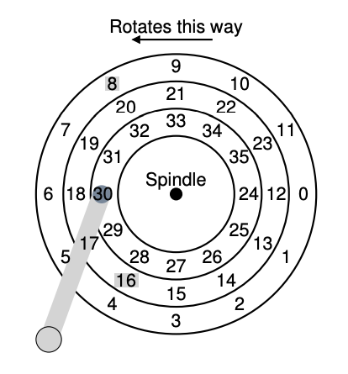
SPTF (Shortest Positioning Time First)
Which to serve, 8 or 16?
Depends on whether seek or rotate is faster

Slide 109
Disadvantage of SPTF?
Easy for far away requests to starve

Slide 110
SCAN
Elevator Algorithm:
Sweep back and forth, from one end of disk other, serving requests as pass that cylinder
Sorts by cylinder number; ignores rotation delays
Pros/Cons?
Better: C-SCAN (circular scan)
Only sweep in one direction
Notes:
SCAN is more friendly to middle tracks.
C-SCAN is more fair to inner and outer tracks.

Slide 111
What happens?
Assume 2 processes each calling read() with C-SCAN
void reader(int fd) {
char buf[1024];
int rv;
while((rv = read(buf)) != 0) {
assert(rv);
// takes short time, e.g., 1ms
process(buf, rv);
}
}

Slide 112
Work Conservation
Work conserving schedulers always try to do work if there’s work to be done
Sometimes, it’s better to wait instead if system anticipates another request will arrive
Such non-work-conserving schedulers are called anticipatory schedulers
Notes:
Work conserving schedulers = 劳模型选手
anticipatory schedulers = 先行/预期调度器 = 智慧型选手
One well-known anticipatory scheduler is the "Anticipatory I/O Scheduler" used in the Linux kernel. It was designed to reduce seek times on traditional spinning hard drives (HDDs) by reordering read and write requests intelligently. However, with the increasing popularity of solid-state drives (SSDs), which have no seek time, the relevance of anticipatory schedulers has diminished. SSDs have much faster random access times, making the seek optimization of traditional HDDs less critical.
In modern computing environments, SSDs are more common, and different I/O scheduling algorithms, like the Completely Fair Queuing (CFQ) scheduler, are used to optimize I/O operations. These schedulers focus on efficiently handling the characteristics of SSDs rather than minimizing seek times.

Slide 113
CFQ (Linux Default)
Completely Fair Queueing
Queue for each process
Weighted round-robin between queues, with slice time proportional to priority
Yield slice only if idle for a given time (anticipation)
Optimize order within queue

Slide 114
I/O Device Summary
Overlap I/O and CPU whenever possible!
use interrupts, DMA
Storage devices provide common block interface
On a disk: Never do random I/O unless you must!
e.g., Quicksort is a terrible algorithm on disk
Spend time to schedule on slow, stateful devices

